Slide 1


Christopher Eberhart
12/02/2022

Slide 2

Outline
Executive Summary
Introduction
Methodology
Results
Conclusion
Appendix

Slide 3
Executive Summary
Summary of methodologies
Data Collection through Web API.
Data loaded into a relation database to utilize SQL commands to cleanup and normalize the data.
Utilized data visualization of static and interactive charts to approach correlations.
Initiated machine learning algorithms to verify hypothesis from visualizations.
Summary of all results
The results were striking in that heavier payloads from the Kennedy Space Center LC-39A launch site would yield the most success for the Falcon 9 booster.

Slide 4
Introduction
Project background and context
In order to maximize the reduction in costs compared to competitors and ensure the success of a launch, it is imperative to examine the real-world success of data. By increasing the chances of success, SpaceX can provide the best value compared to its competitors.
Problems you want to find answers
What factors were more likely to reenter and land successfully.
What characteristics of a launch had a higher probability of success.

Slide 5

Section 1

Slide 6
Methodology
Executive Summary
Data collection methodology:
Data was collected through utilization of the web scraping API’s in Python through publicly available data.
Perform data wrangling
Missing data points were dropped from the analysis in order to preserve real-world outcomes.
Perform exploratory data analysis (EDA) using visualization and SQL
Perform interactive visual analytics using Folium and Plotly Dash
Perform predictive analysis using classification models
Compared the outcome of various modeling to find the best predictor.

Slide 7
Data Collection
Describe how data sets were collected.
Data collection was through utilizing Python and its extensive libraries to scrape the web through built-in API into a dataframe.

Slide 8

Data Collection – SpaceX API
Utilize a web API call to SpaceX to collect the data needed to complete the analysis.
Link for API code is https://github.com/SineOverdirve/CapstoneProject/blob/07001f00bd848873744b6372b5f7c95b1c6d9200/jupyter-labs-spacex-data-collection-api.ipynb

Slide 9

Data Collection - Scraping
Utilizing BeautifulSoup in Python, scrapped data from Wikipedia on the Falcon 9.
https://github.com/SineOverdirve/CapstoneProject/blob/17c14a6722b62db1d53ddfd799dcce63d0703c4f/jupyter-labs-webscraping.ipynb

Slide 10
Data Wrangling
Combined the data from the SpaceX API call data and what was scrapped from the Falcon 9 Wikipedia page.
Calculated number of launches at each site along with destination orbital region.
Through wrangling also created a binary outcome of the launch if success or failed.
https://github.com/SineOverdirve/CapstoneProject/blob/17c14a6722b62db1d53ddfd799dcce63d0703c4f/Capstone%20Project%20Data%20Wrangling.ipynb

Slide 11
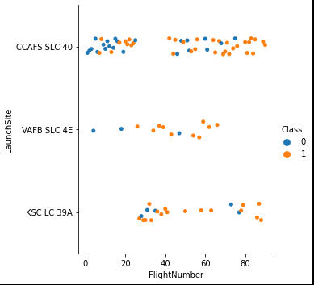

EDA with Data Visualization
Utilized a scatter plot of payload vs launch site to find the better location along with a bar chart of the success rate by orbit.
https://github.com/SineOverdirve/CapstoneProject/blob/3a87b5d4e73ef8cba4244ee6a5c5f4b0628fc780/EDA%20with%20Visualization%20Lab.ipynb

Slide 12
EDA with SQL
Loaded the SpaceX dataset into a PostgreSQL database and confirmed data loaded correctly with jupyter notebook.
Applied EDA utilizing SQL to gain insight through queries:
The unique launch site names and identifiers.
The payload mass carried by each Falcon 9 launch.
The average payload mass carried by the Falcon 9 booster.
The total count of successful and failure missions.
The failed landing outcomes in drone ship, their booster version and launch site names.
https://github.com/SineOverdirve/CapstoneProject/blob/3a87b5d4e73ef8cba4244ee6a5c5f4b0628fc780/Capstone%20EDA%20w_SQL.ipynb

Slide 13
Build an Interactive Map with Folium
Utilizing the Folium library, all launch sites are marked with a marker, circle, and text. Additionally, each site shows the number of launches with a marker along with green for successful and red for failure.
These objects were added to provide us with a quick visual representation of what sites were used more often along with which had more successful uses of the Falcon 9 booster.
https://github.com/SineOverdirve/CapstoneProject/blob/3a87b5d4e73ef8cba4244ee6a5c5f4b0628fc780/Launch%20Site%20Location%20Lab.ipynb

Slide 14
Build a Dashboard with Plotly Dash
Through the use of the Plotly library, interactive charts were able to be examined to look for trends.
Through using a scatter plot of the payload vs the Falcon 9 booster version, we gain insight into what version is showing the most success.
Utilizing a pie chart of the launch locations and number of successful missions, we can visually see which sites provide the best probability of a successful outcome.
https://github.com/SineOverdirve/CapstoneProject/blob/3a87b5d4e73ef8cba4244ee6a5c5f4b0628fc780/spacex_dash_app.py

Slide 15
Predictive Analysis (Classification)
Utilized the numby, pandas, and scikit learn libraries to be able to ETL the data and run against various ML algorithms.
By spinning the data and pushing it through the various classification models, we were able to determine that the decision tree provided the most accurate predictor.
https://github.com/SineOverdirve/CapstoneProject/blob/3a87b5d4e73ef8cba4244ee6a5c5f4b0628fc780/SpaceX_Machine%20Learning%20Prediction_Part_5.ipynb

Slide 16
Results
The decision tree predictor gave us an accuracy against the test data of 87.5%

Slide 17

Section 2

Slide 18
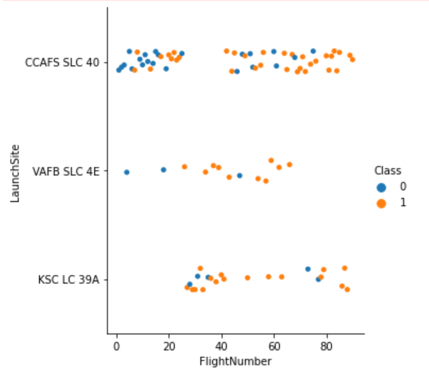
Flight Number vs. Launch Site
Through a scatter plot visualization, we were able to determine that LC-39A at Kennedy Space Center provided the highest probability of success.

Slide 19
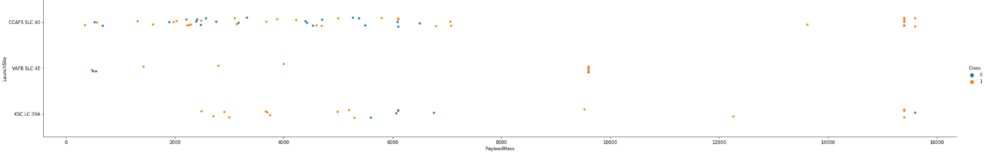
Payload vs. Launch Site
Utilizing a scatter plot visualization, we were able to see that heavier payloads led to a high chance of success at each site.

Slide 20

Success Rate vs. Orbit Type
Using a bar chart visualization, we can see that ES-L1, GEO, HEO, SSO, and VLEO have the higher probability of success.

Slide 21

Flight Number vs. Orbit Type
Using a scatter plot visualization of the orbit type vs the iteration of attempts, we can see a strong correlation of the GTO orbit leading to more successes.

Slide 22

Payload vs. Orbit Type
Through the use of a scatter plot of payloads vs orbit, there is a greater chance of success using the LEO and ISS orbits.

Slide 23

Launch Success Yearly Trend
On the line plot, we can see that the success rate has increased quite rapidly from 2013 to 2017 and has held nearly steady at 80%.

Slide 24
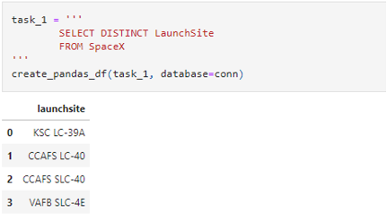
All Launch Site Names
Attached is a screenshot of the query used to compile the unique launch sites utilized by SpaceX for the Falcon 9 booster.

Slide 25
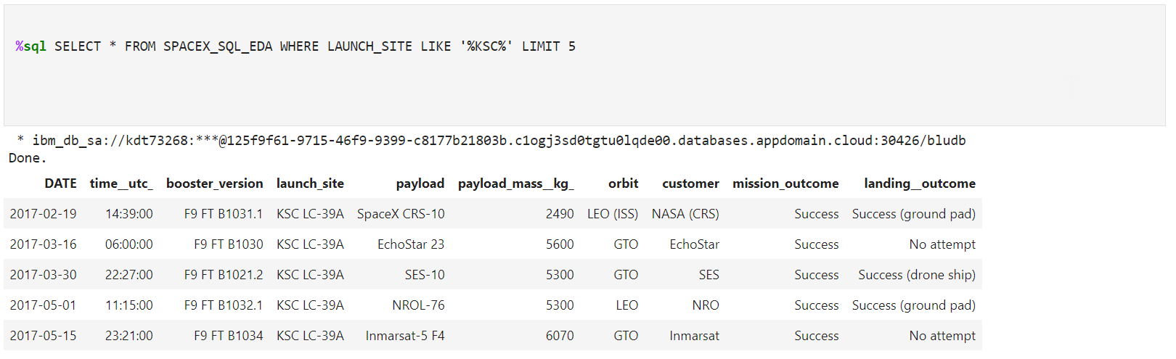
Launch Site Names Begin with 'KSC'
Find 5 records where launch sites’ names start with `KSC`

Slide 26
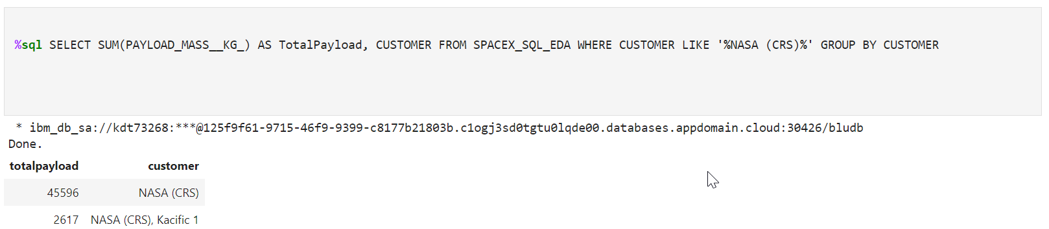
Total Payload Mass
Calculate the total payload carried by boosters from NASA

Slide 27
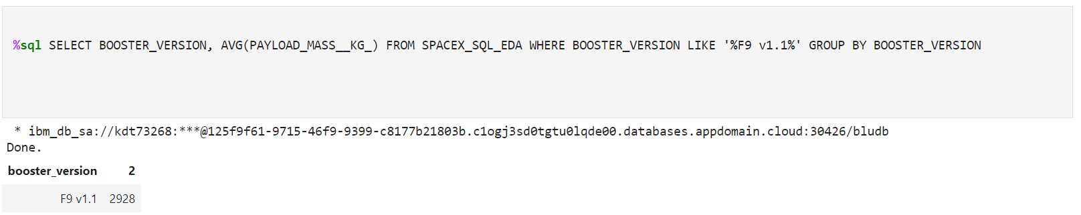
Average Payload Mass by F9 v1.1
Calculate the average payload mass carried by booster version F9 v1.1

Slide 28
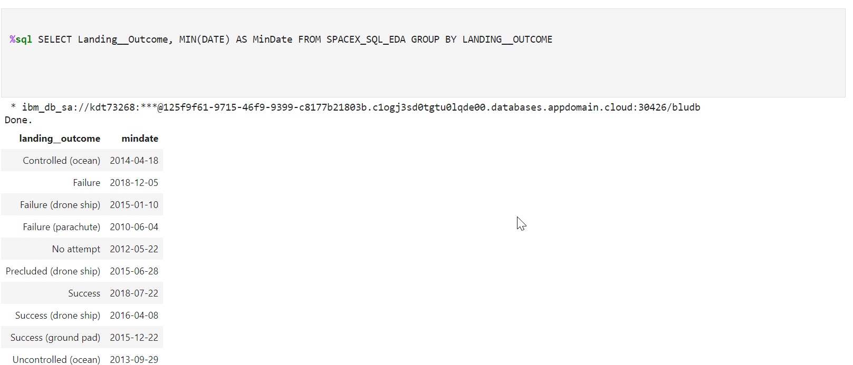
First Successful Ground Landing Date
The screenshot of the query shows that the first successful landing of a booster to the ground was on December 22nd, 2015.

Slide 29
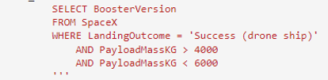
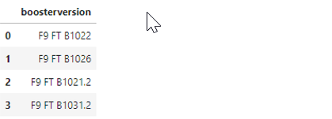
Successful Drone Ship Landing with Payload between 4000 and 6000
Using a Select query with a between in the where clause, we are able to find all the drone ship landings that were successful that carried payloads between 4000 to 6000 kg.

Slide 30
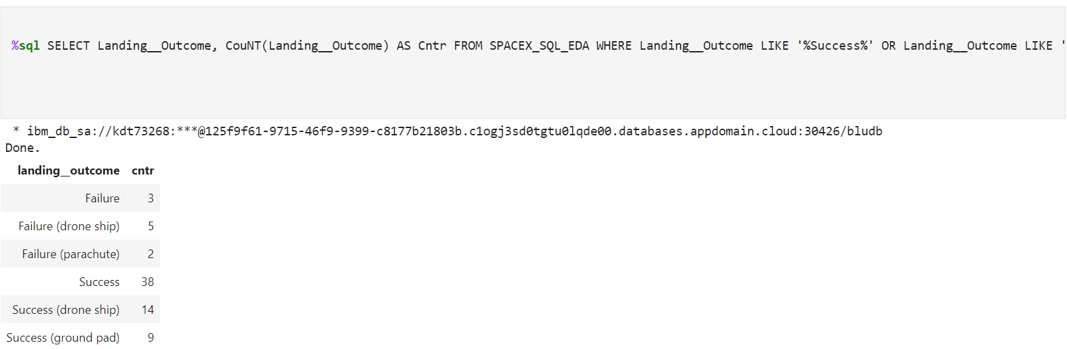
Total Number of Successful and Failure Mission Outcomes
Through a count with a group by, we are able to count the number of missions that resulted in a success or failure. This approach was used instead of wild card on “fail” or “success” to show the breakdown of each category.

Slide 31
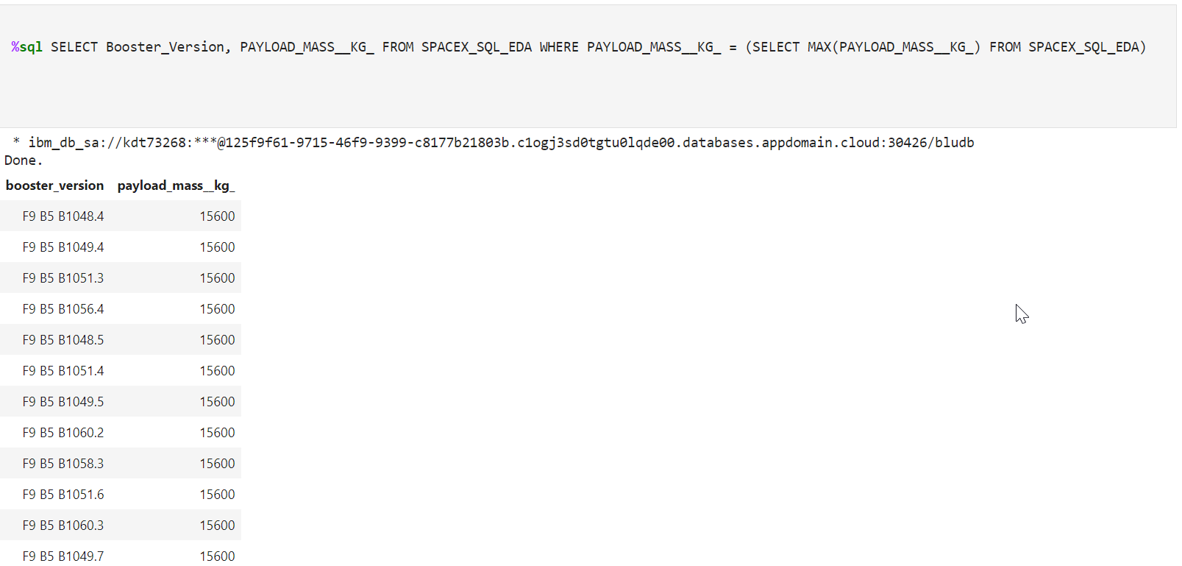
Boosters Carried Maximum Payload
The attached screenshot shows all boosters that launched at max capacity.

Slide 32
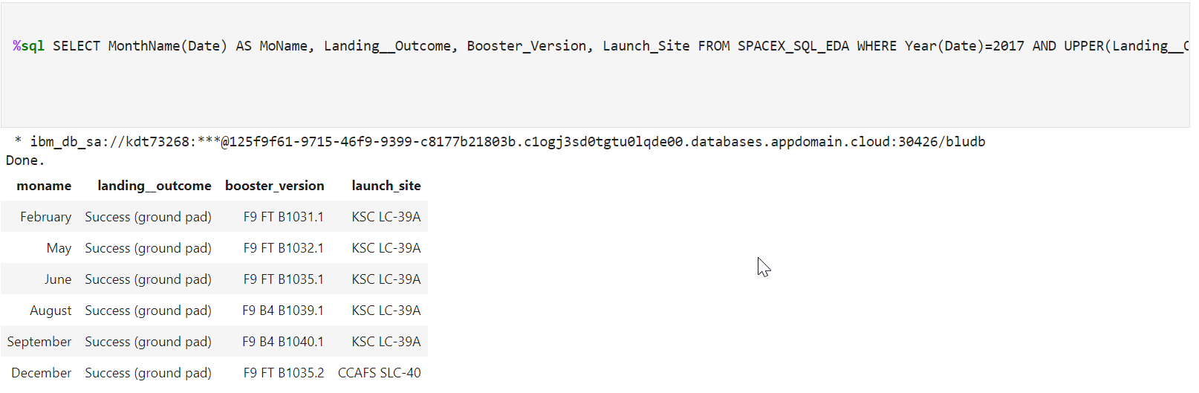
2017 Launch Records
The attaches screenshot shows the records by month names that resulted in successful landing outcomes in the year 2017.

Slide 33
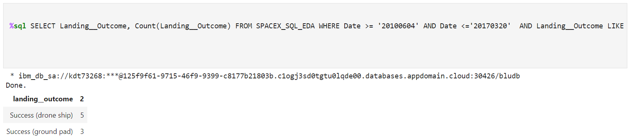
Rank Landing Outcomes Between 2010-06-04 and 2017-03-20
The attached screenshot shows the query and count of successful landing outcomes between the date 2010-06-04 and 2017-03-20 in descending order.

Slide 34

Section 3

Slide 35
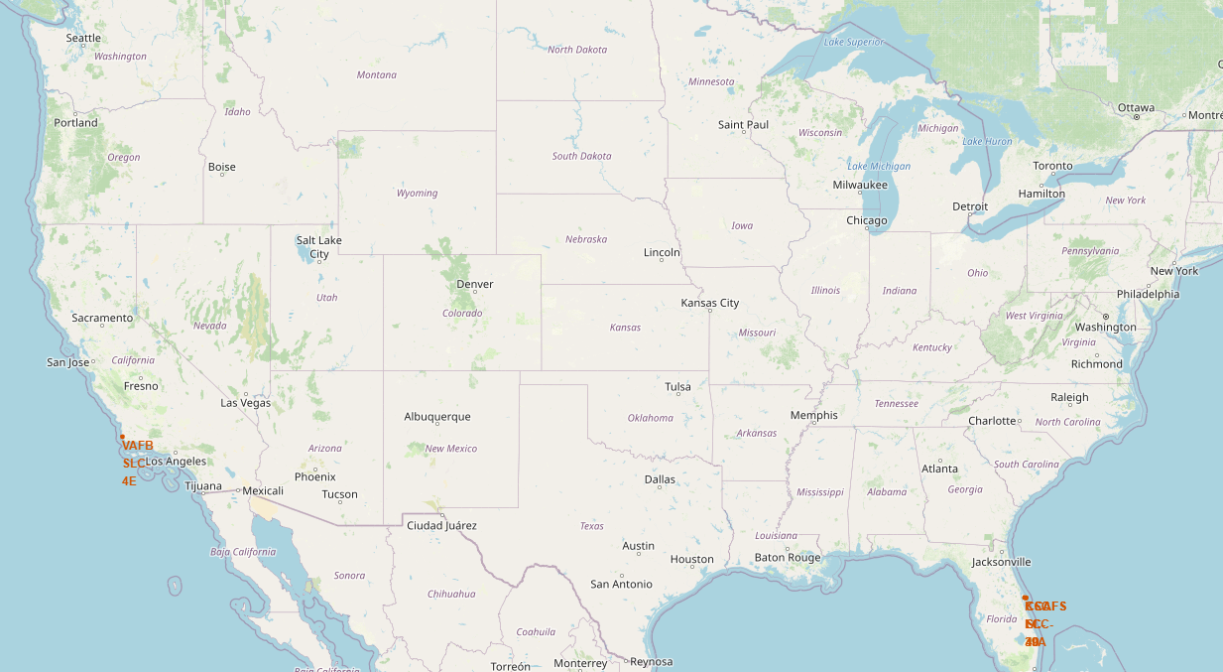
All launch sites displayed

Slide 36
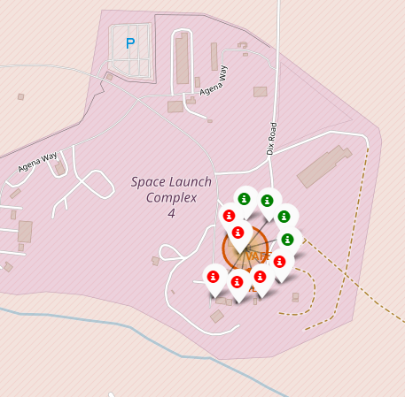
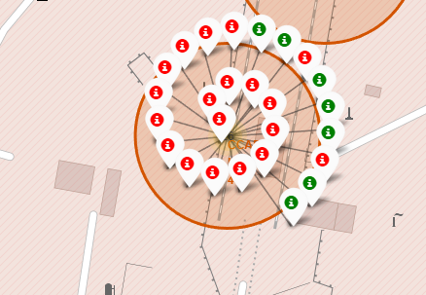
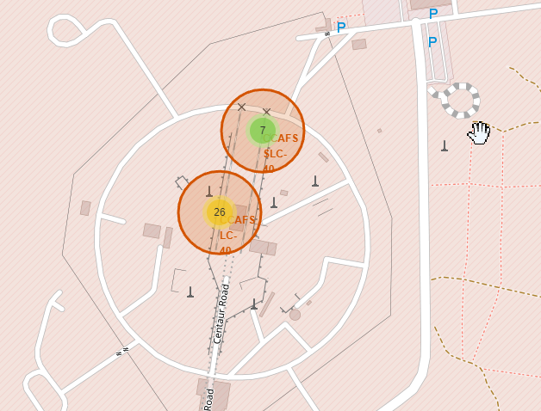
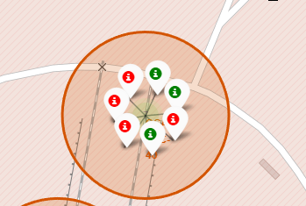
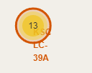
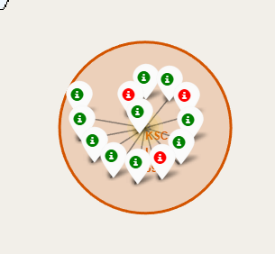
Launch Site Markers with Success Icons

Slide 37
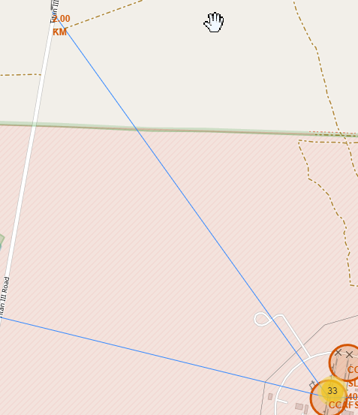
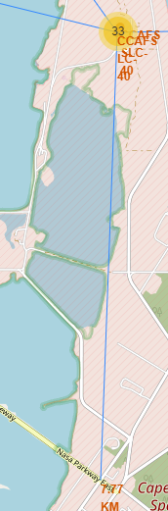
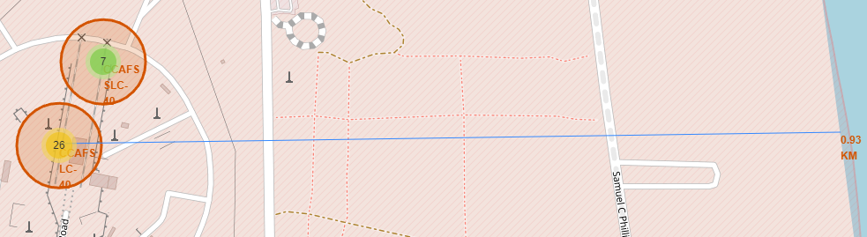
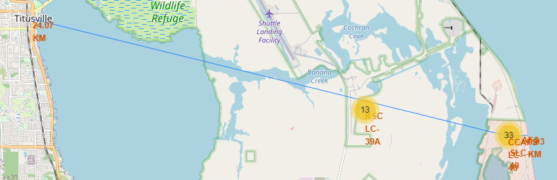
Showing Distances to Major land markers
Nearest coast line
Nearest major road
Nearest rail line
Nearest major population center

Slide 38

Section 4

Slide 39
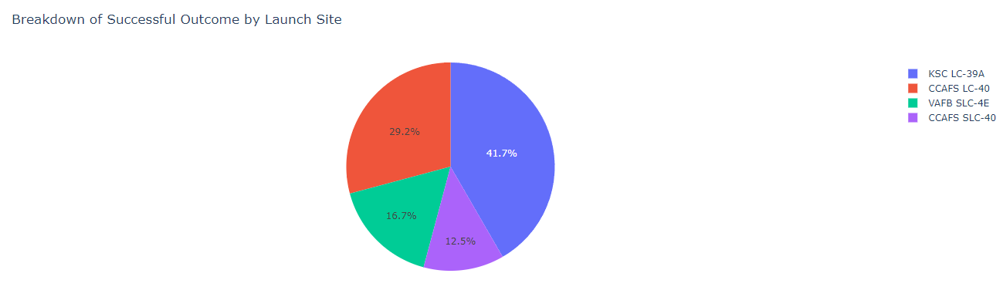
Pie chart showing the success percentage achieved by each launch site
From the pie chart we can see that KSC LC-39A has the best success rate.

Slide 40
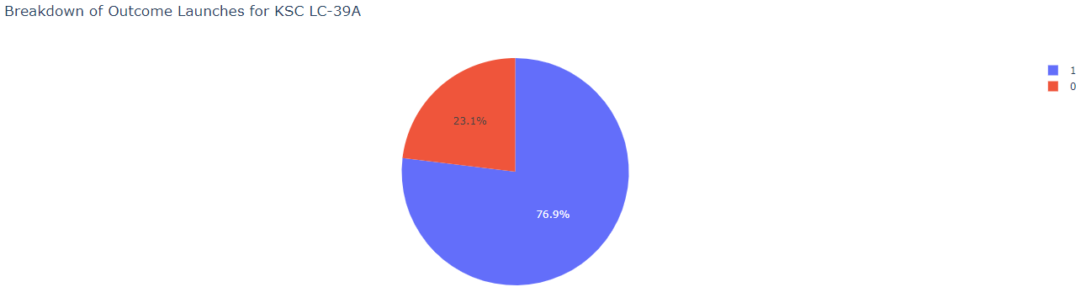
Pie chart showing the KSC LC-39A site success rate

Slide 41
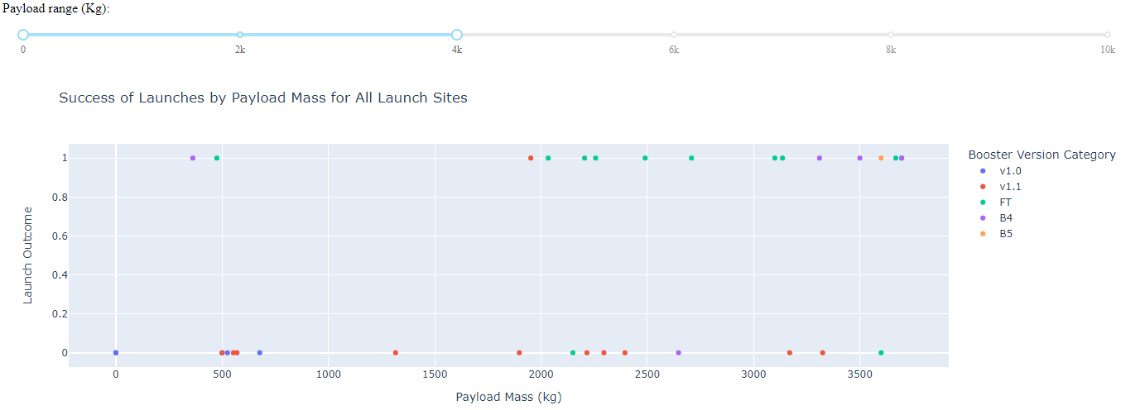
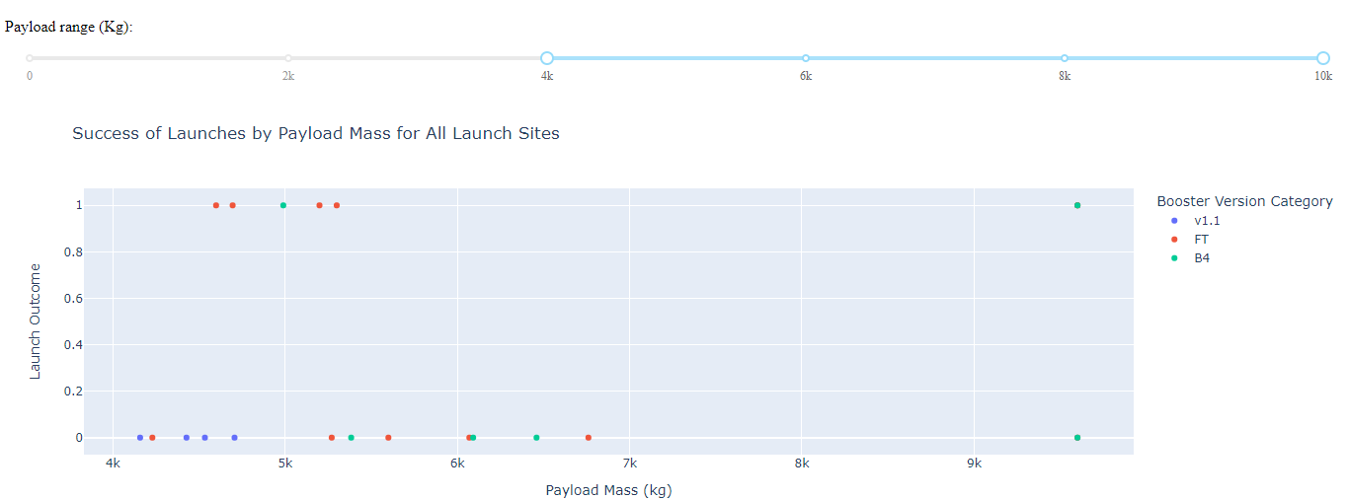
Scatter plot of Payload vs Launch Outcome for all sites, with different payload selected in the range slider
We can see that heavier payloads led to a higher success rate.

Slide 42

Section 5

Slide 43
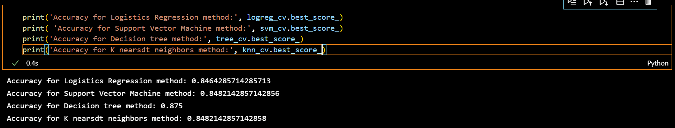
Classification Accuracy
Below is a screenshot showing the various classification models along with their best score. We can see that the decision tree method led to the most accurate results.

Slide 44

Confusion Matrix
Attached is the confusion matrix for the decision tree classification model using the best parameters.

Slide 45
Conclusions
In conclusion the following can be gleaned from the data:
The best launch site is LC-39A at Kennedy space center.
If the target orbit is ES-L1, GEO, HEO, SSO, or VLEO then the booster has a greater chance of reusability.
We can calculate the probability of success to 87.5% using the decision tree classification machine learning model.
Knowing this we will be able to adjust our pricing to remain competitive and profitable based on the input parameters.

Slide 46


